Slide 1
Introduction to deep learning

Slide 2

What is deep learning?
Wikipedia says:
“Deep learning is a branch of machine learning based on a set of algorithms that attempt to model high-level abstractions in data by using multiple processing layers, with complex structures or otherwise, composed of multiple non-linear transformations.”
High-level
abstraction
Machine
Learning
Network

Slide 3
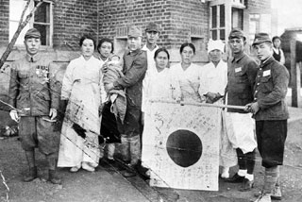
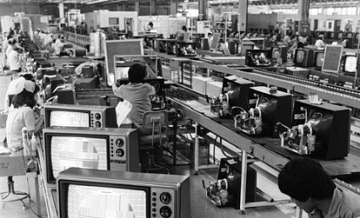
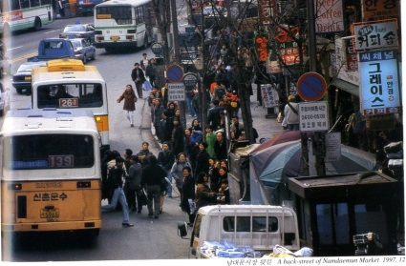
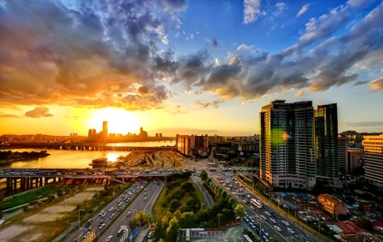
Is it brand new?
Neural Nets
McCulloch & Pitt 1943
Perception
Rosenblatt 1958
RNN
Grossberg 1973
CNN
Fukushima 1979
RBM
Hinton 1999
DBN
Hinton 2006
D-AE
Vincent 2008
AlexNet
Alex 2012
GoogLeNet
Szegedy 2015

Slide 4
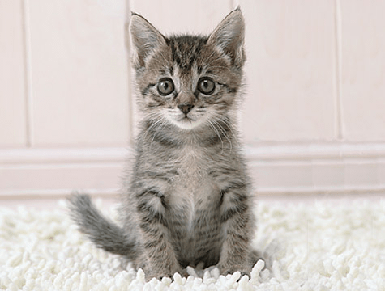
Learning representation
ML/AI: how do we learn features?
What is the fundamental rule?
What is the learning algorithms?
Trainable Feature Transform
Neuroscience: how does the cortex learn perception?
Trainable Feature Transform
CogSci: how does the mind learn abstract concepts on top of less abstract ones?
Deep learning addresses the problem of learning hierarchical representation with a single algorithm.
“Deep Learning Tutorial” by LeCun

Slide 5
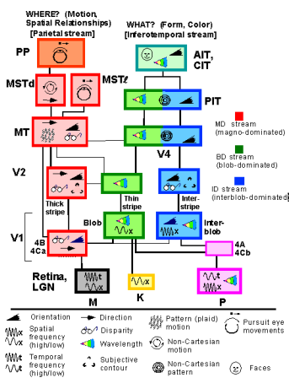
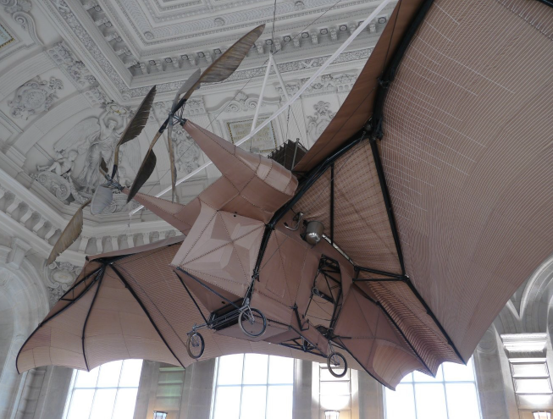
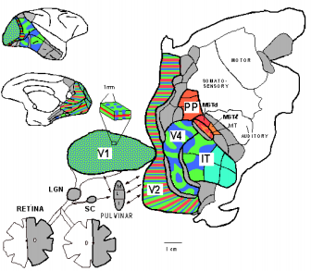

Inspired by nature?
L'Avion III de Clement Ader, 1897
Sure there is some resemblance!
But, do not go TOO FAR.
“Deep Learning Tutorial” by LeCun

Slide 6
Deep architectures
Feed-Forward: multilayer neural nets, convolutional nets
Feed-Back: Stacked Sparse Coding, Deconvolutional Nets
Bi-Directional: Deep Boltzmann Machines, Stacked Auto-Encoders
Recurrent: Recurrent Nets, Long-Short Term Memory

Slide 7
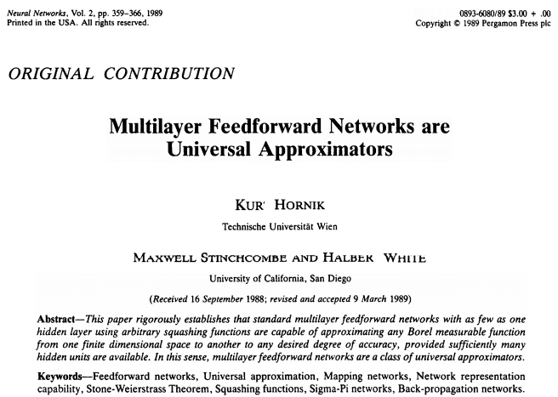
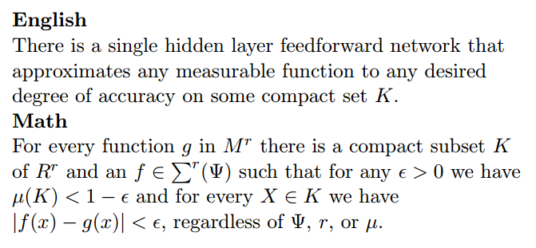
Theoretically
Cited > 12,000

Slide 8
Empirically
Deep machines are more efficient for representing certain classes of functions, particularly those involved in visual recognition.
In other words, they can represent more complex functions with less “hardware”.
In fact, it works out perfectly in a number of competitions.
The researchers say even they weren’t sure this new approach (152 layers!) was going to be successful – until it was.
“We even didn’t believe this single idea could be so significant,”
said Jian Sun, a principal research manager at Microsoft Research
http://blogs.microsoft.com/next/2015/12/10/microsoft-researchers-win-imagenet-computer-vision-challenge/

Slide 9
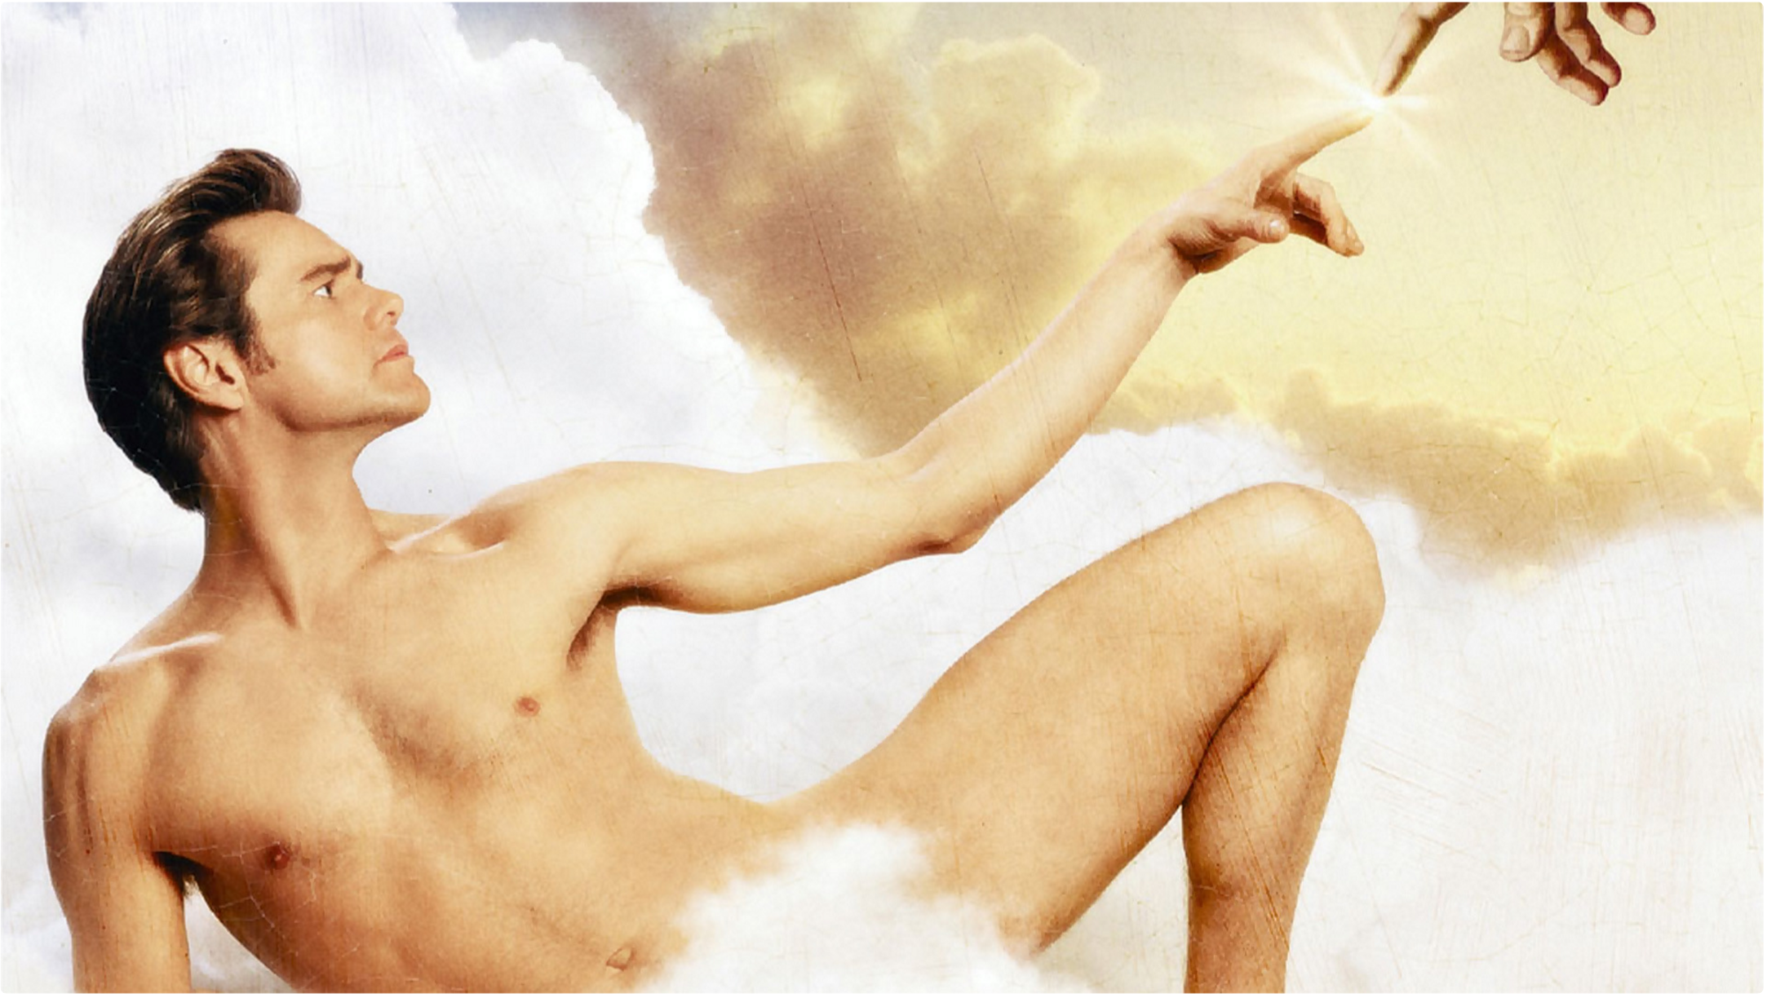
Omnipotent?

Slide 10
Applications

Slide 11
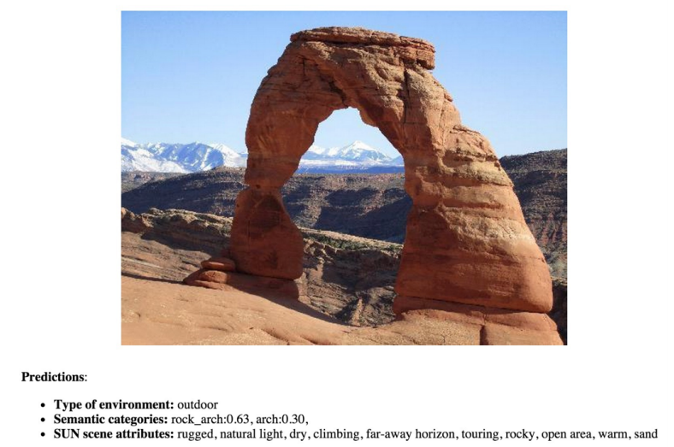
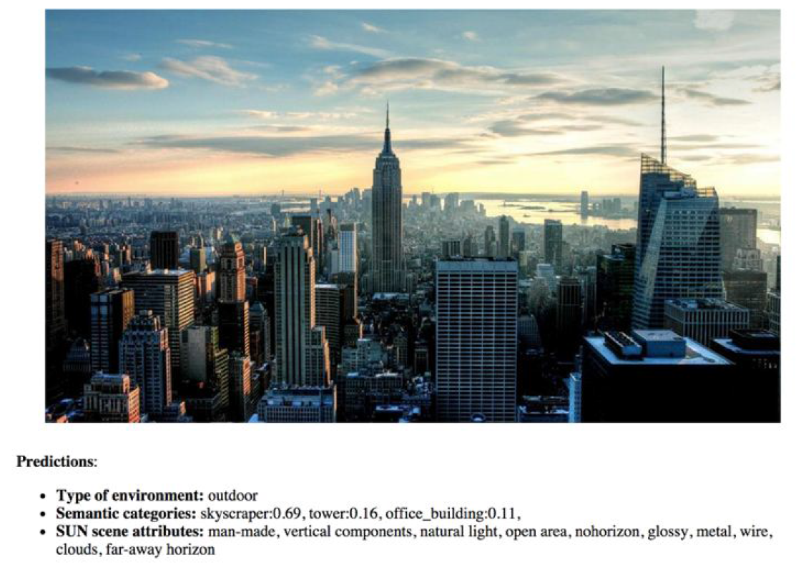
Scene Recognition (CNN)
B. Zhou, A. Lapedriza, J. Xiao, A. Torralba, and A. Oliva. “Learning Deep Features for Scene Recognition using Places Database.” Advances in Neural Information Processing Systems 27 (NIPS), 2014.

Slide 12
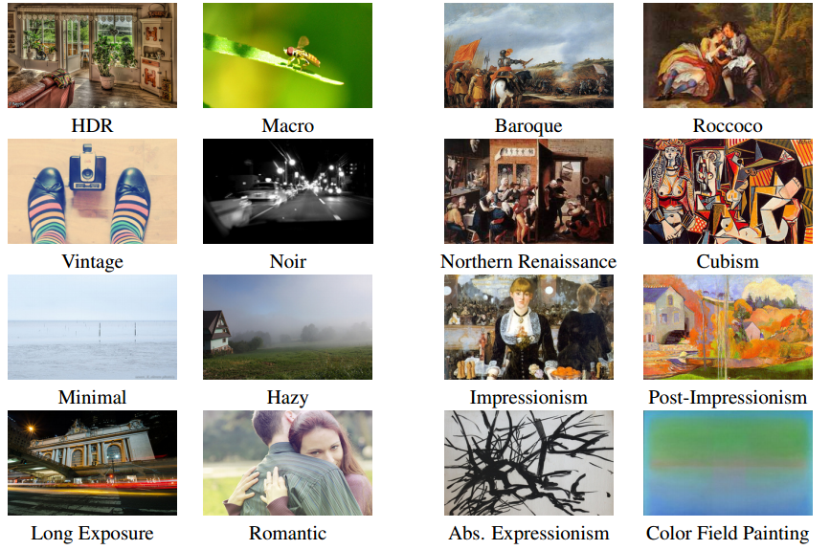
Visual Style Recognition (CNN)
Karayev, Sergey, et al. "Recognizing image style." arXiv preprint arXiv:1311.3715 (2013).

Slide 13
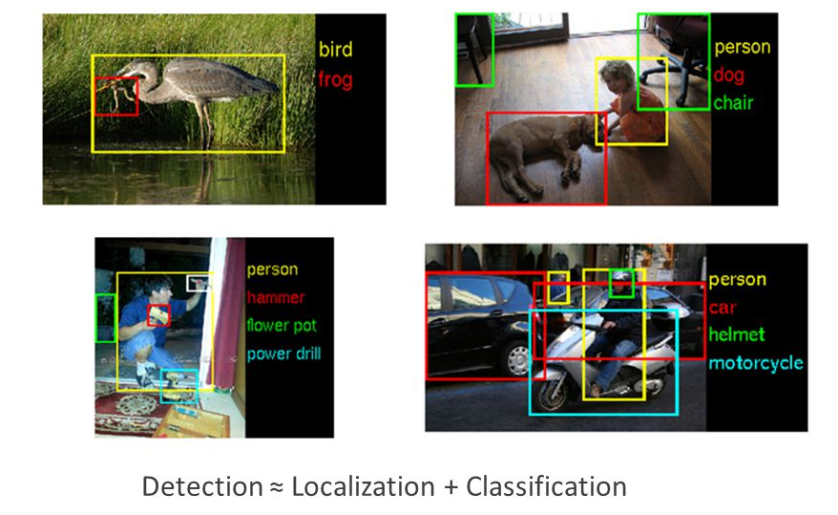
Object Detection (R-CNN)
Girshick, Ross, et al. "Region-based convolutional networks for accurate object detection and segmentation." Pattern Analysis and Machine Intelligence, IEEE Transactions on 38.1 (2016): 142-158.

Slide 14
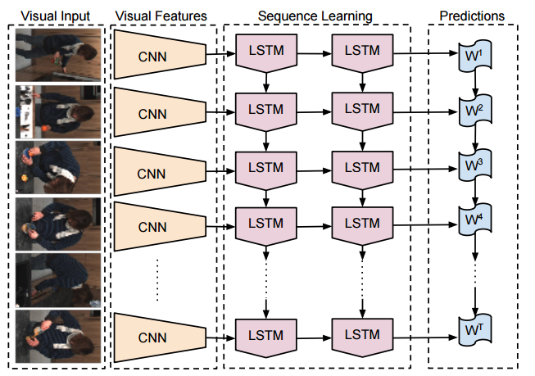
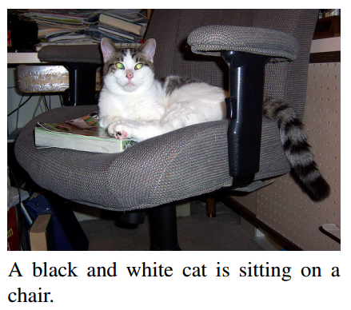
Image Captioning (CNN+LSTM)
Donahue, Jeffrey, et al. "Long-term recurrent convolutional networks for visual recognition and description." Proceedings of the IEEE Conference on Computer Vision and Pattern Recognition. 2015.

Slide 15
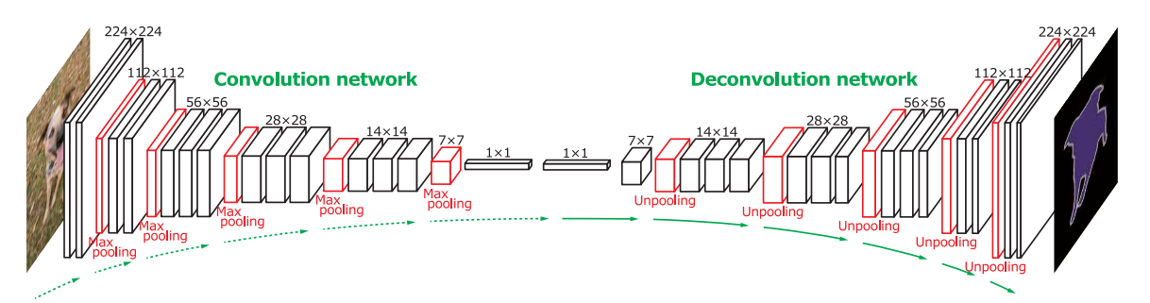
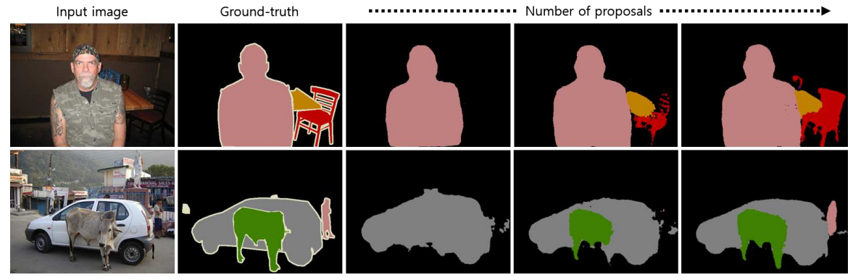
Segmentation (DeconvNet)
Hyeonwoo Noh, Seunghoon Hong, Bohyung Han, Learning Deconvolution Network for Semantic Segmentation, arXiv:1505.04366.

Slide 16
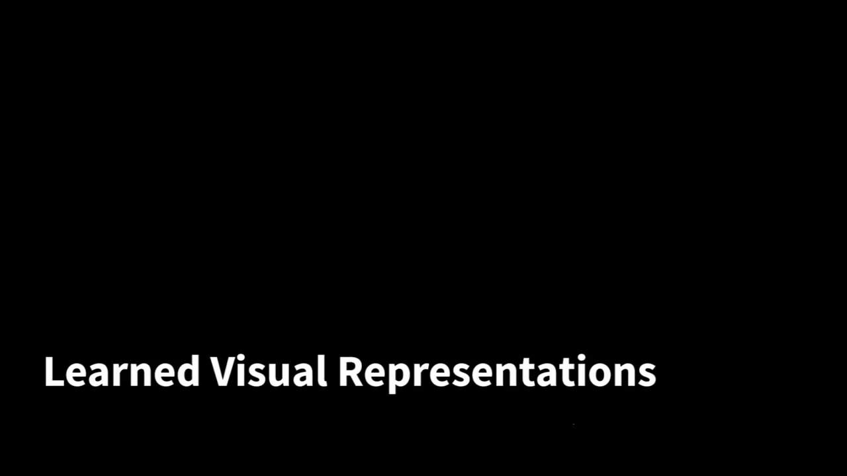
Deep Visuomotor Control (CNN)
Levine, Sergey, et al. "End-to-end training of deep visuomotor policies." arXiv preprint arXiv:1504.00702 (2015).

Slide 17
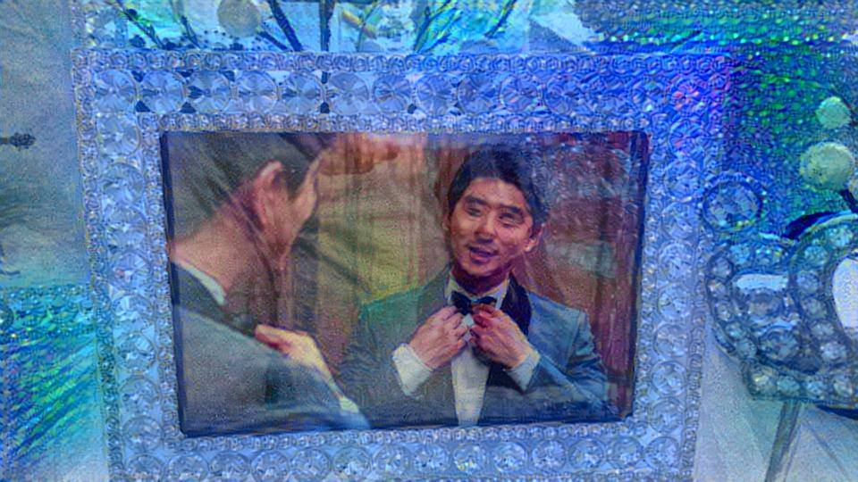
Neural Style (CNN)
Gatys, Leon A., Alexander S. Ecker, and Matthias Bethge. "A neural algorithm of artistic style." arXiv, 2015

Slide 18
Tools

Slide 19
Deep learning tools?
MatConvNet
Theano
TensorFlow
Torch
Caffe

Slide 20
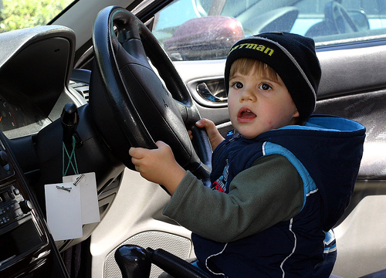
To tell the truth

Slide 21
Caffe
From U.C. Berkeley
Written in C++
Good for training or fine-tuning feedforward models

Slide 22
Caffe
Blobs: Store data and derivatives
Layer: Transform bottom blobs and top blobs
Net: Many layers; computes gradient via forward / backward
Solver: Uses gradients to update weights
Data (Layer)
W
InnerProduct (Layer)
SoftMax (Layer)
F
X
Y

Slide 23
Caffe
(+) Good for feedforward networks (CNN)
(+) Good for fine-tuning existing networks
(+) Train models without writing any code
(+) Python interface is pretty useful
(-) Need to write C++ / CUDA for new GPU layers
(-) Not good for recurrent networks
(-) Cumbersome for big networks (GoogLeNet, ResNet)

Slide 24
Torch
From NYU
Written in C and Lua
Used a lot in Facebook and DeepMind

Slide 25
Torch
(+) Easy to write your own layer types and run on GPU
(+) Many available library codes and packages
(+) Lots of pretrained models
(+) Lots of modular pieces that you can combine
(-) Lua
(-) Less plug-and-play than Caffe
(-) Not great for RNNs

Slide 26
Theano
From University of Montreal
Embracing computation graphs, symbolic computation
High-level wrappers: Keras, Lasagne

Slide 27
Theano
(+) Python + numpy
(+) Computational graph is cool
(+) Good for RNNs
(+) High level wrappers ease the pain
(-) Not enough pretrained models
(-) Error messages can be unhelpful
(-) Raw Theano is somewhat low-level

Slide 28
TensorFlow
From Google
Very similar to Theano
Easy visualizations
Multi-GPU and multi-node training

Slide 29
TensorFlow
(+) Python + numpy
(+) Computational graph is cool
(+) Much faster than Theano
(+) Easy to modify nets
(-) Not many pretrained model (but it will get better)
(-) Training time is slower than others right now
(-) Can hack into the networks

Slide 30
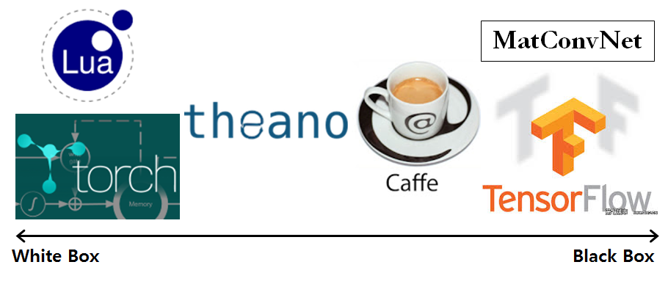
White to black

Slide 31
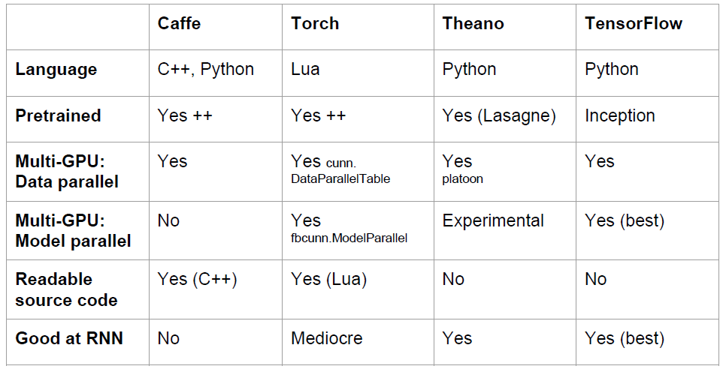
Overview

